Slide 1
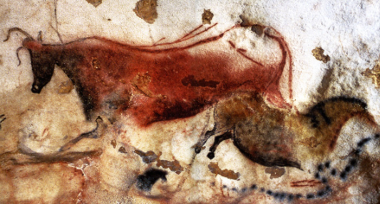
Hominid Evolutionary Trends
Ch 20 Cultural Evolution

Slide 2
Intro
In addition to anatomical and physiological evolution, hominins have developed complex cultures that allow them to survive better in their environment.
Cultural evolution can be seen in:
  Tool and technology development
  Development of methods for obtaining food
  Increasing sophistication of language
  Other changes including symbolic representation (eg visual art)

Slide 3
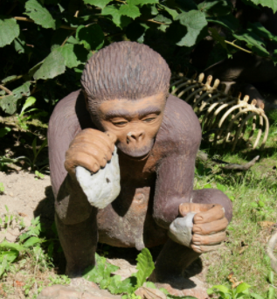
Australopithecine Culture
Home bases:
  Lived in one place, left from there to forage for food
Use of fire?
  No evidence found that Australopithecines deliberately used or controlled fire.
Tools
  Limited evidence that tools were made, but rocks and sticks were likely used as tools.

Slide 4
Early homo
  Larger brains than Australopithecines
  Needed more complex fats and higher levels of protein
  Therefore needed to consume meat.
  Food sharing from large hunts would have been necessary – collaboration and interdependence
  Males likely hunted, females gathered
  Majority of food from gathering, with occasional large bounty from hunt
  Cooperative culture requires development of language – not as complex as modern humans
  Evidence of hunting: stone tools and also marks on bone to indicate tools not teeth used.

Slide 5
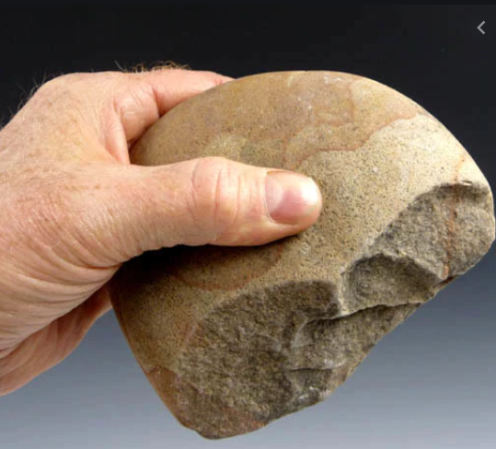
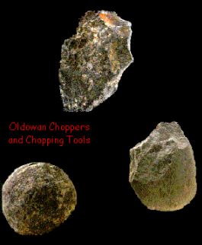
Homo habilis culture
Tool Use – Oldowan Tools
  Range of pebble tools found: choppers, scrapers, flakers, chisels
  Require precision grip
  Tool use enabled colonisation of a broader range of habitats

Slide 6
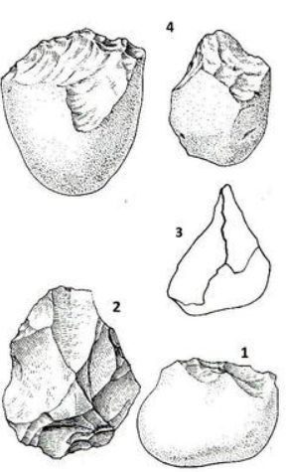
Oldowan tools examples
Note
Rough flaking
Unsophisticated
Not developed for specific purpose eg arrowhead/fish hook/knife etc.

Slide 7
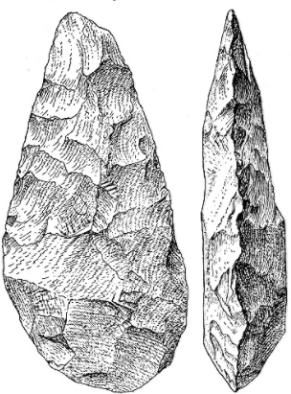
Homo erectus Culture
Modified environment to suit own purposes
Home bases:
  Built shelters to protect from the elements
  Terra Amata: site dating to 400 000 years ago
    Wood huts
    Evidence of fire use
    Tools from stone and bone
    Remnants of animal bone from hunting - also fish bones – fishing?
Use of fire?
  Evidence that H.erectus used fire:
    Kept predators away
    Warmth and light
    Used during hunting to drive animals
    Cooking of food
Tools
  Flaked around all edges, teardrop shaped “hand axes”
  Referred to as Acheulean tools (from where they were first discovered)

Slide 8
Homo erectus Culture
Food:
  Hunter- gatherer society
    Most food from gathering, supplemented by hunting
  Skilful, strategic hunters
    Evidence of planning – planned baboon slaughter miles away from base
    Drove elephants into swamps using fire, then butchered them
    Sophisticated, systematic butchering using tools
  Women used complex techniques and collaboration to gather food.
    Balanced with child rearing
Social organisation
  A result of hunting/gathering/use of tools and fire
  Complex society, shared care
  Relatively complex social language may have developed.

Slide 9
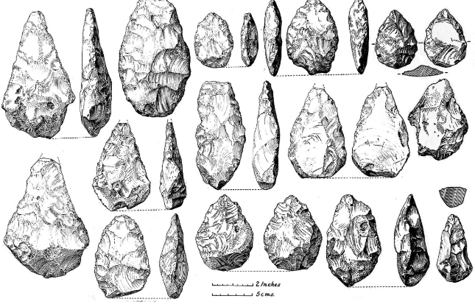
Acheulian tools – Homo erectus
Rough tear-drop shape
Not a lot of variation
General rather than specific use
Finer flaking than Oldowan
Bifacial – thin axe-like edges with two broader faces.

Slide 10
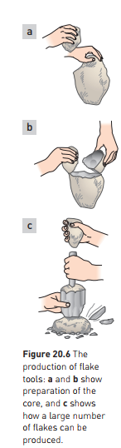
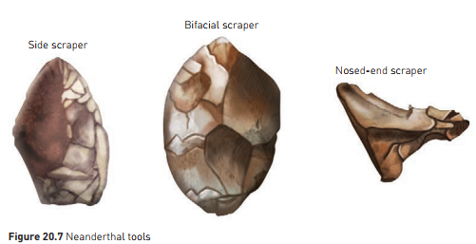
Neanderthal Culture
Further cultural advances – well able to manipulate environment
Tool making
  Production of stone flakes which could then be trimmed to form various tools.
  “Mousterian Industry” – advance over hand axes
  Allowed clothing to be made

Slide 11
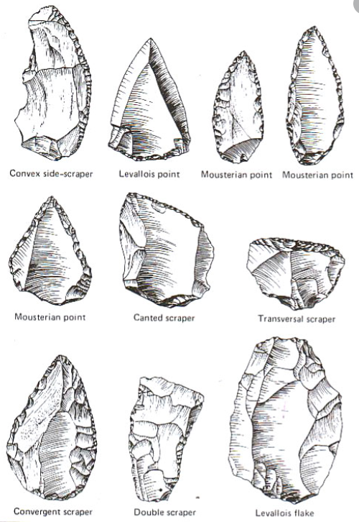
Mousterian Tools – Neanderthal Culture
Variety of tool shapes to suit different purposes eg scraping, stabbing
Relatively fine flaking to edges for sharpness

Slide 12
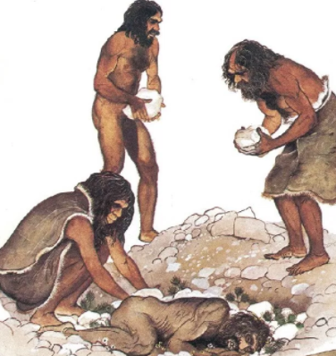
Neanderthal Culture
Burial of dead
  With symbolic objects eg goat horns, flowers
  Evidence of spiritual/religious belief?
Shared care and responsibility
  Likely that Neanderthals took care of the disabled and elderly
  Developed social system for sharing of food and other resources

Slide 13
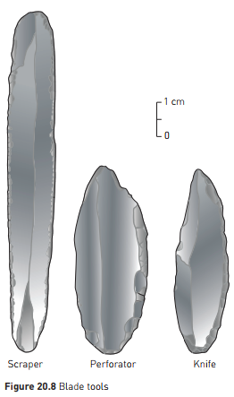
Transition to Modern Humans
50 000 years ago – new technologies
  Finer blades
  Projectile weapons
  Sewn clothing
  Better shelters
Blade tools:
  Sharp, parallel sides – like a knife blade
Sophisticated hunting techniques
  Meat, skins, oil for fire/lamps
  Bones and ivory used to make tools

Slide 14
Transition to Modern Humans
3 main cultures in fossil record for Homo sapiens
  Aurignacian (40 000 – 28 000 bce)
  Solutrean (21 000 – 17 000 bce)
  Magdelanian (17 000 – 12 000 bce)

Slide 15
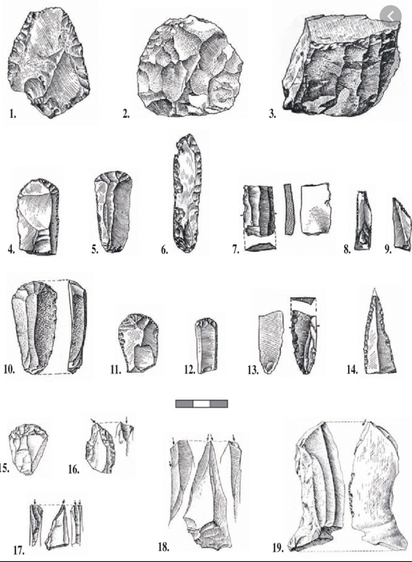
Aurignacian Tools
40 000 – 28 000 bce
Finer workmanship
Wide variety of tools for different purposes

Slide 16
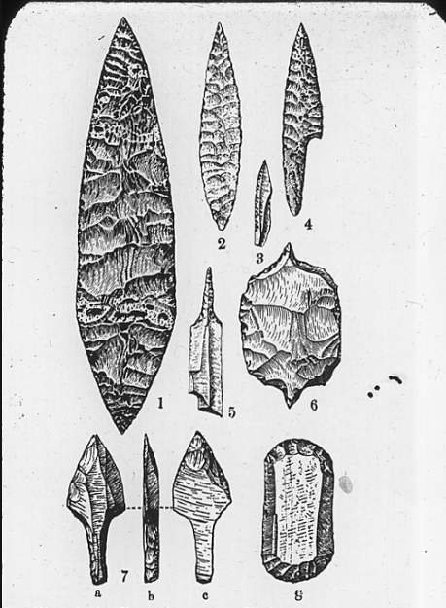
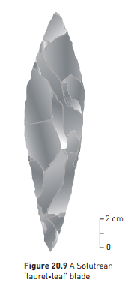
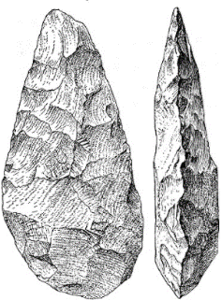
Solutrean Tools
21 000 – 17 000 bce
  Variety of tools were made for different purposes
  Complex, fine blades, pressure flaking
  Symbolic blades were made in some instances.
Note: comparing Solutrean to Acheulian (Homo erectus) tools - solutrean tools have finer flaking and are much smaller and more elongated than the H. erectus tools
Acheulian hand axe

Slide 17
Transition to Modern Humans
Magdelanian
  Bone and antler tools predominated
    Barbed spears
    Spear throwers
    needles
  Tool for making other tools – a stone “burin” chisel used for carving bone and antler
  Some clay modelling
  Art works
    Portable – carved figurines
    Mural art on cave walls
    Use of colour and shading

Slide 18
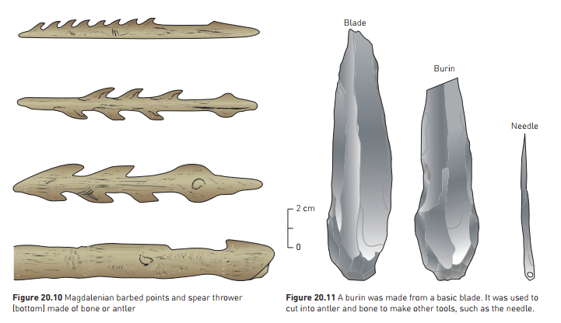

Slide 19
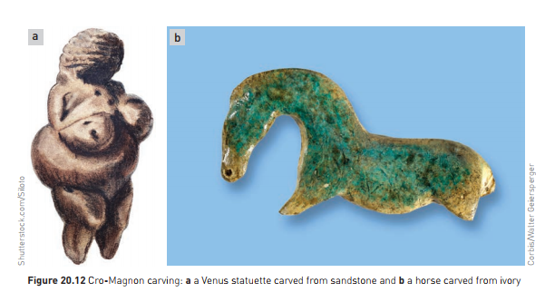

Slide 20
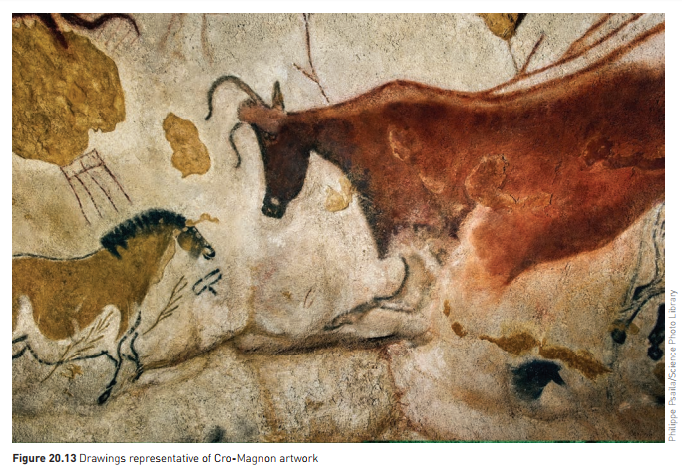

Slide 21
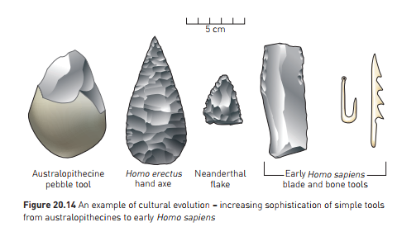

Slide 22
The beginning of agriculture
Big step in human history
Change from nomadic to village lifestyle
“Neolithic revolution”
Domestication of plant and animal species
Likely to have begun in South-West Asia, around Palestine
  “Fertile Crescent”
  12 500 years ago
  Gathered wild grasses, which hybridised
  Fertile hybrid: “Emmer”
  Later hybrid; large grains, good for making flour, but could no longer by scattered by wind: had to be sown – agriculture!

Slide 23
The beginning of agriculture
Domestication of crops occurred independently at different sites around the world:
  China – rice, millet, soybeans, yams
  Central America – maize (corn), potato, sweet potato, bean, peanut, pumpkin, tomato
  New World; more plants domesticated. Old World – more animals domesticated
11 000 years ago: animals domesticated
  Sheep – south west asia
  Pigs, cattle, goats, and other animals, over a longer period of time
Farming supplemented by fishing and hunting
Surplus grain could be stored
More people could be supported on less land
Settled life allowed development of new technologies

Slide 24
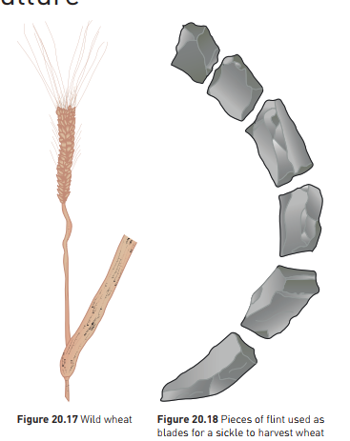

Slide 25
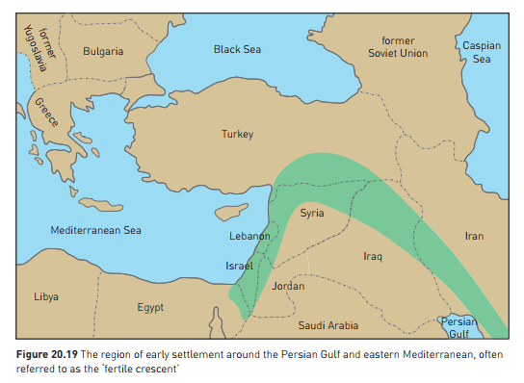

Slide 26
Modern Humans
We are able to manipulate our environment to a high level
  Travel
  Medical technology – life expectancy
  Complex society
Important to understand human origins
  Helps understand modern humans
  Lifestyle diseases often because our cultural evolution has outstripped our biological evolution
Still challenges to survival, some of our own making
  Climate change an immediately pressing issue
  May be able to evolve culturally so we are able to slow down or reverse the change we are making.

